Slide 1
Tuning
How to guide

Slide 2
Introduction
Bow
Arrows
Why Tune?
Archer
Requires consistent technique

Slide 3
Topics
Bareshaft Tuning (Main method of tuning)
Walk-back Method (Outdoors)
Bracing Height Tuning
This guide will assume that the bow has been setup already in terms of basic setup:
Bracing Height
Tiller
Nocking Point
Limb Alignment

Slide 4
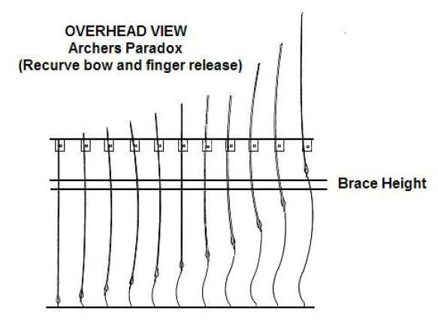
Archers Paradox
Arrows don’t fly in straight lines
Archers Paradox video: https://www.youtube.com/watch?v=wGNslUNBrEM
Spine video: https://www.youtube.com/watch?v=96KGWC0PB6s
Image Source: Archery Australia- Recurve bow tuning

Slide 5
Arrow Spine
Different arrows are different thicknesses, which is called their spine
This will cause arrows to bend different amounts
Look up your arrow spine on the Easton Arrow chart when you know your bow weight and drawlength
Generally with aluminium arrows, the higher the spine number, the stiffer it is while the reverse is true for carbon arrows
Image Source: Easton Arrow Tuning and Maintenance Guide

Slide 6
Spine values
Aluminium arrows
Carbon arrows
Outer diameter : 19/32 “
Inner diameter : 16/64 “
1916 spine
Deflection in /1000” when hang 1 pound weight off
Higher first 2 digits + Lower last 2 digits = stiffer arrow
Lower number = stiffer arrow

Slide 7
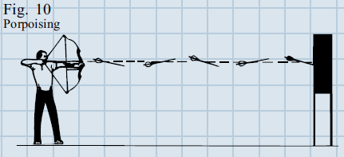
Arrow flight
You may notice that your arrows are behaving oddly when in the air
Fishtailing occurs when the nock moves from side to side on release
Porposing occurs when the nock position is wrong
However, both of these can also be caused be a bad loose
Image Source: Easton Arrow Tuning and Maintenance Guide

Slide 8
Bareshaft tuning

Slide 9
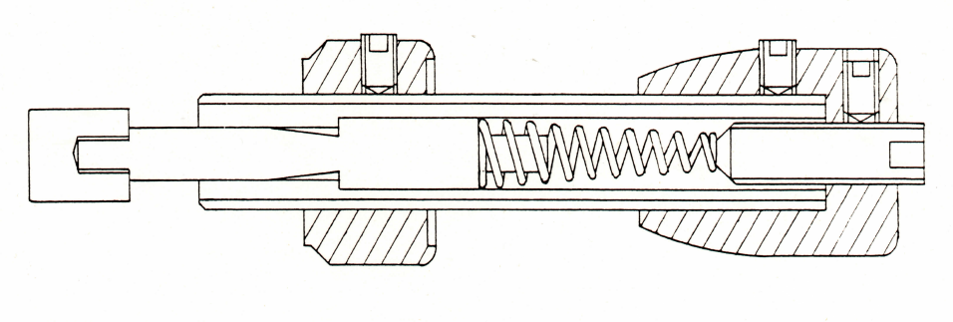
Bareshaft Tuning
AIM OF THIS METHOD: Get the bareshaft into the group of fletched arrows
Uses an unfletched arrow (an arrow without any fletches on)
Fletches are used to stabilise the flight of an arrow
Image Source: Personal Communication with county coach

Slide 10
Method
Can be done indoors/outdoors
If done outdoors, do on a calm day
Setup a boss at 20 yards-30 m
Shoot a group of fletched arrows and then shoot a bareshaft
Several ends should be shot to allow consistency
Adjust as per the diagrams on the next slides

Slide 11
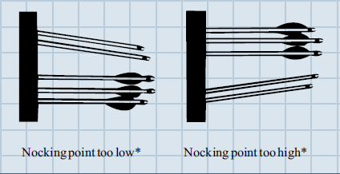
Vertical variation
Indicates the nocking point is in the wrong position
May cause clearance issues
To correct: Move Nocking point in direction of bareshaft (follow the arrow)
Image Source: Easton Arrow Tuning and Maintenance Guide

Slide 12
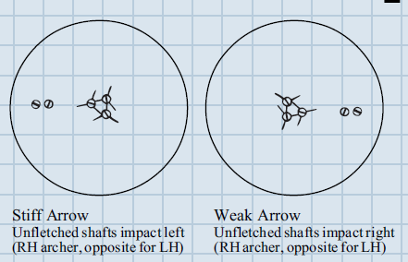
Horizontal Variation
Images for a RH archer (reverse will apply for LH)
Hint: Use the pressure button to force the bareshaft into group.
To correct: Decrease pressure on pressure button
To correct: Increase pressure on pressure button
Image Source: Easton Arrow Tuning and Maintenance Guide

Slide 13
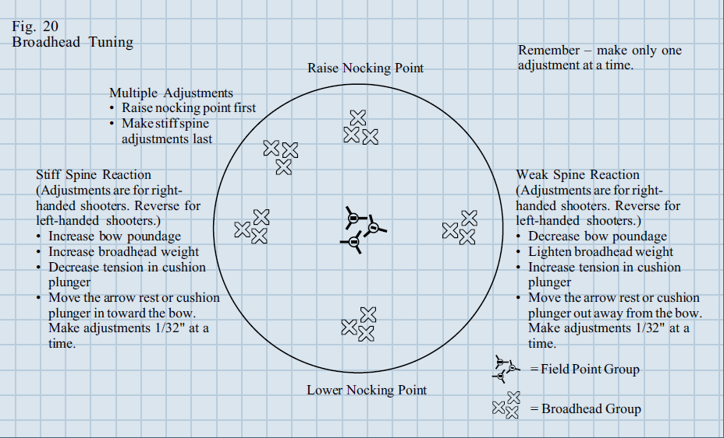
Extra info
Fletched Arrow
Bareshaft
Image Source: Easton Arrow Tuning and Maintenance Guide

Slide 14
Walk-Back Method

Slide 15
Method
Another method for tuning outdoors
Essentially, setup a target and starting from a short distance and moving back, see where the arrows go
This method takes a while to do, so either do when very few people are around or setup separate shooting line

Slide 16
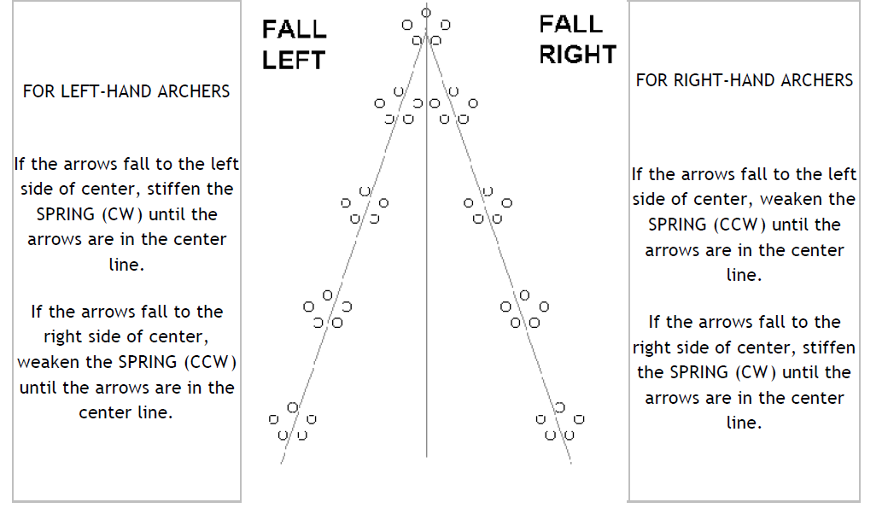
Movement of groups
Look at where the group moves as you go back
Image Source: Tune for Tens- Rick Stonebraker

Slide 17
Bracing height Tuning

Slide 18
Method
Bracing height can be adjusted to make the bow quieter
The quieter the bow is, the more efficient it is.
Remove all stabilisation from the bow
Set the bracing height to the lowest recommended for the riser ( roughly 8.5” for a 68” bow)
Shoot a group of arrows at 10-20yrds in the centre of the boss and note how large the group is
Increase the bracing height by 1/8” and shoot another group, noting the group size
Repeat up till the maximum bracing height for the riser (roughly 9.5” for a 68” bow)

Slide 19
Results
Should get a bell shaped curve for the group size
Set the bracing height to where the smallest group was achieved
This is when the bow should also be at its quietest
Now put the stabilisers back on and enjoy having a very quiet bow

Slide 20
Other things to consider
Length of fletches
Point weight
Arrow length
Poundage
Stabiliser setup
Centre shot
Tiller
YOUR TECHNIQUE!!!

Slide 21
Questions?

Slide 22
EXTRA

Slide 23
Dynamic Stiffness
Adjustments to increase dynamic spine, “making the arrow shoot stiffer
• decrease point weight
• add weight to the nock end of the arrow
• shorten the shaft
• decrease bow weight
• decrease brace height. Be careful here as this gives a longer power stroke thus makes the arrow seem weaker.
• increase string weight
• change arrows to a stiffer shaft size, i.e., lower static spine value.
Adjustments to decrease dynamic spine, “making the arrow shoot weaker or bend more”
• increase point weight
• lengthen the shaft
• increase bow weight
• increase brace height be careful here as this gives a shorter power stroke thus makes the arrow seem stiffer.
• decrease string weight
• change arrows to a weaker shaft size, i.e., increase static spine value.

Slide 24
Limitations
The point weights are determined by what can be purchased
add lead to the inside of the point to increase its weight for aluminium arrows
can cut off some of the arrows shaft to shorten it but you can’t lengthen the shaft without purchasing new shafts
If you increase bow weight you may get to the point the bow is too heavy for you to control
Change from brass nocking points to tie-on ones to increase speed of arrows (increase by 5 feet/sec for each removed)

Slide 25
Tiller adjustments
Decrease tiller- bottom out or top in or both
Increase tiller- bottom in or top out or both

